Slide 1
“PARWAH360”
By
Mahak Singhal
Tina baid

Slide 2
Index
Introduction
Architecture
Technology Platforms used for the project
User roles and responsibilities
Future extension and scope
Conclusion

Slide 3
Introduction
Parwah360 – Hospital Management System
"Care from all angles" – merging technology with healthcare.
Centralized platform for hospital operations.
From patient registration to payment processing in one system.
Web-based, secure, and efficient for patients, doctors, and admins.
Built with Spring Boot, .NET, Hibernate ORM, and JWT security.
Microservices architecture for scalability and modularity.
Automation & integration to reduce manual workload and errors.

Slide 4
Technology Platforms Used for Project
Frontend: ReactJS, HTML, CSS, JavaScript, Bootstrap
Backend: Spring Boot (Java – STS4 IDE), .NET Core (C# – Visual Studio)
Database: MySQL with Hibernate ORM
Security: JWT (JSON Web Token) Authentication, Spring Security
Architecture: Microservices-based design
Development Tools: STS4, Visual Studio, VS Code, Postman
Version Control: Git & GitHub
Server: Apache Tomcat / IIS
API Communication: RESTful APIs

Slide 5
User Roles And Responsibilities
🧑‍⚕️ Doctors
Manage appointments & schedules
Access patient records & history
Create/update prescriptions
Record diagnoses & treatments
🧑 Patients
Register profiles
Book appointments
View prescriptions & medical history
Make secure online payments

Slide 6
User Roles And Responsibilities
👩‍💼 Administrators
Add, update, and manage specializations.
Add and manage doctor profiles.
Add, view, edit, and delete receptionist records.
Monitor hospital staff details and contact information.
🧑‍💼 Receptionist
Add new patient records with personal, contact, and medical details.
View and manage existing patient profiles.
Act as the first point of contact for patient queries and registrations.
Ensure accuracy of patient data in the system.

Slide 7
Future Extension and Scope
Pharmacy Integration – Manage in-house pharmacy inventory & billing.
Online Doctor Consultation – Meet doctors virtually through video calls.
Blood Donation Management – Maintain donor records & organize donation drives.
Lab Test Booking – Schedule blood tests and other diagnostics online.
Expanded Medical Tests – Add modules for multiple health checkups & test reports.

Slide 8
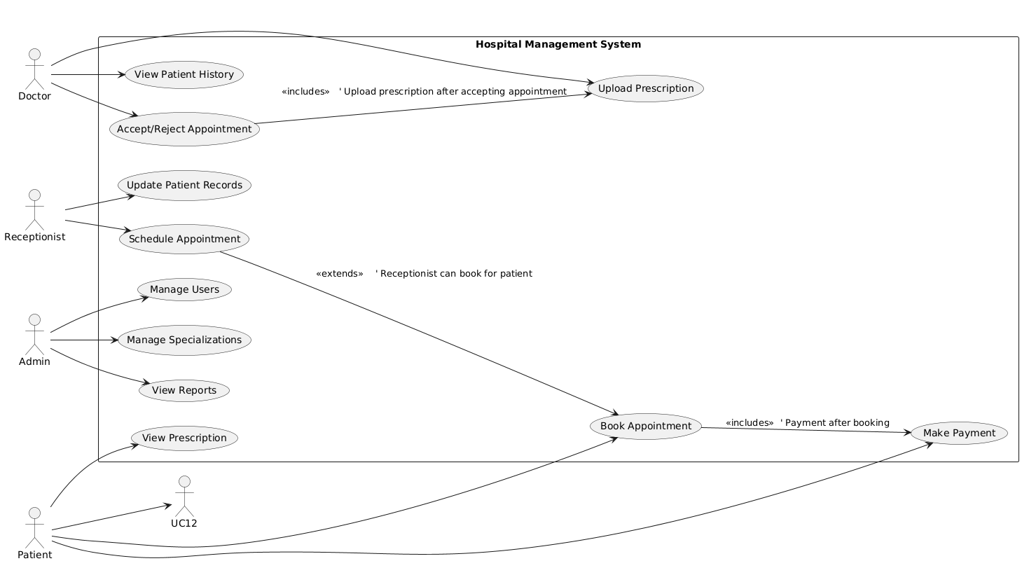
Use Case

Slide 9
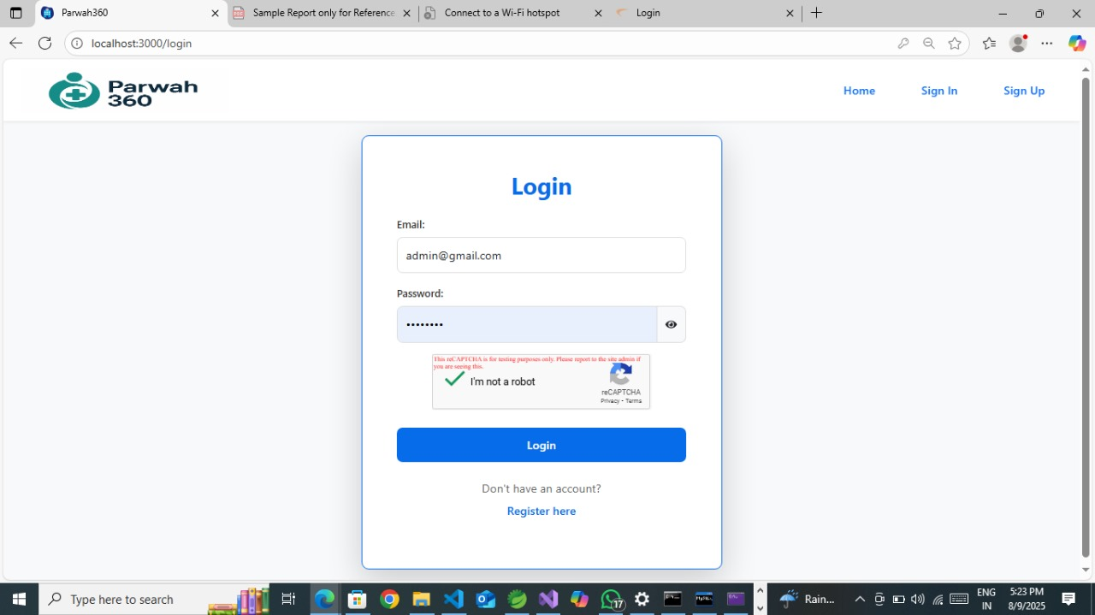
Login Page

Slide 10
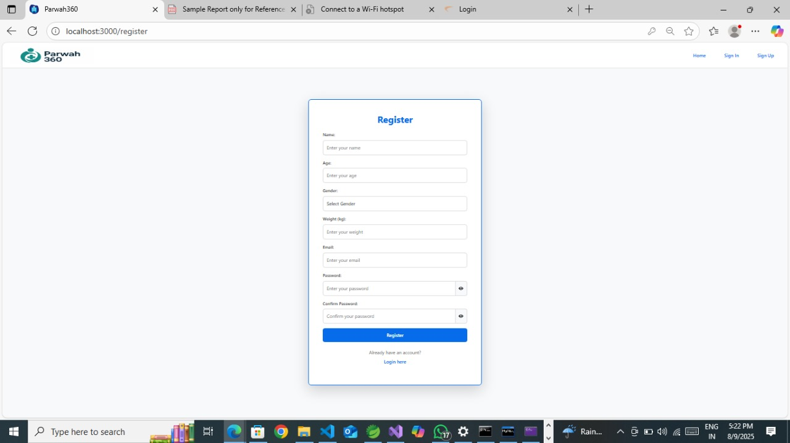
Register Page

Slide 11
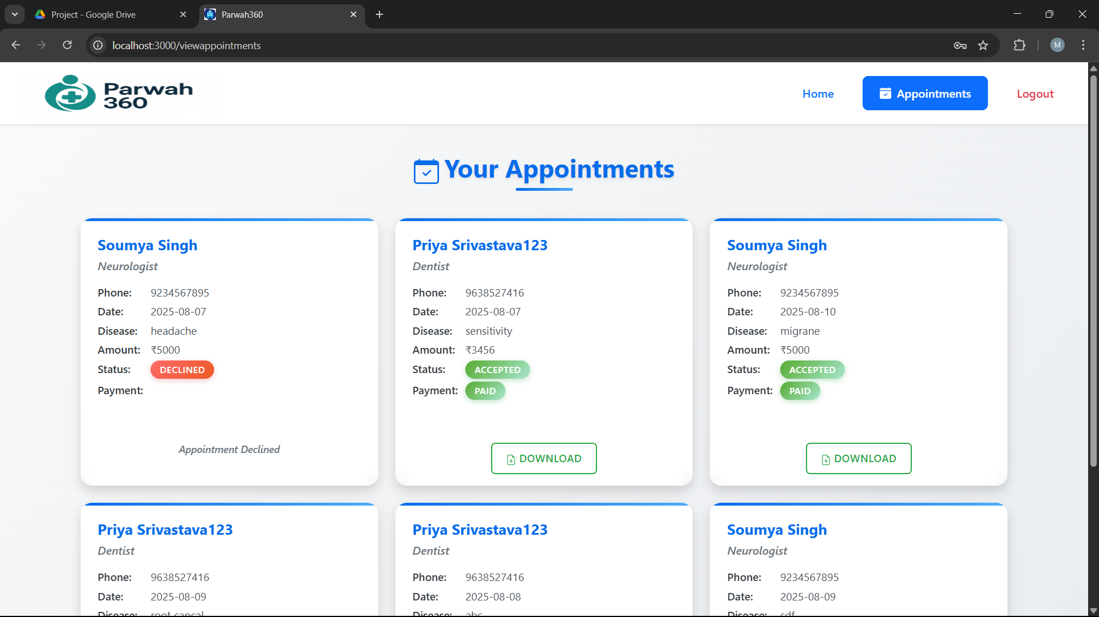
Patient Dashboard

Slide 12
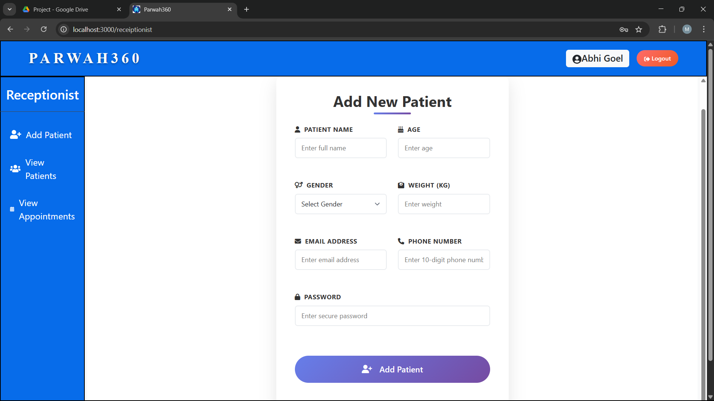
Receptionist Dashboard

Slide 13
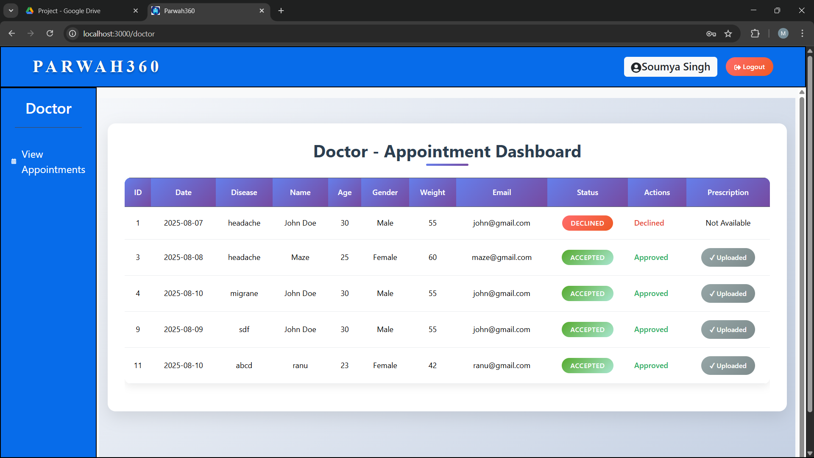
Doctor Dashboard

Slide 14
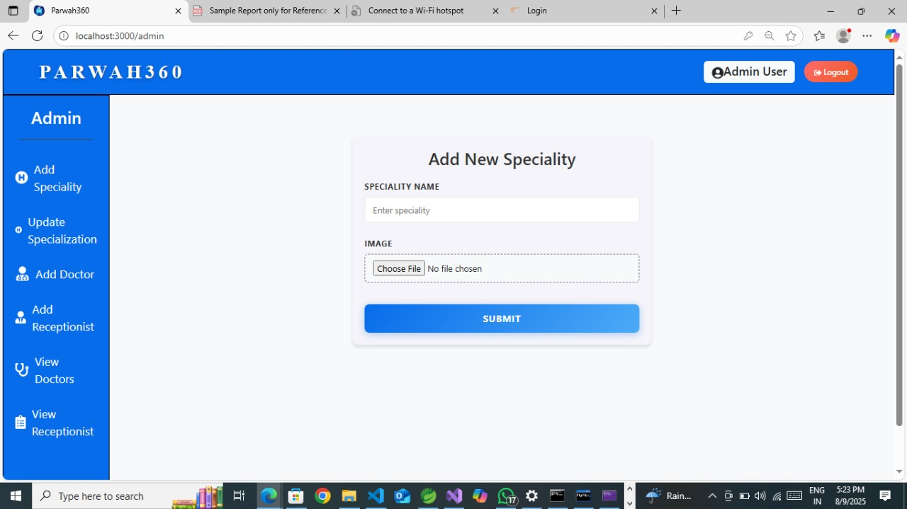
Add Specialization

Slide 15
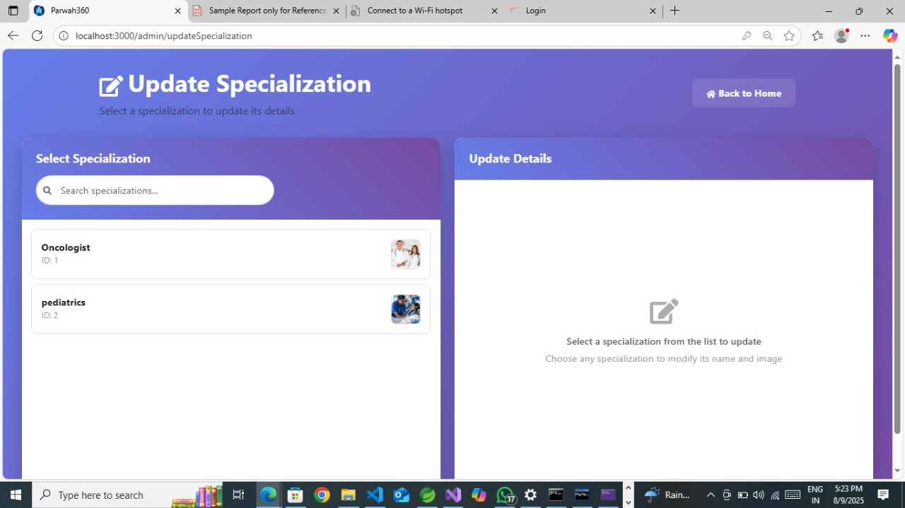
Update Specialization

Slide 16
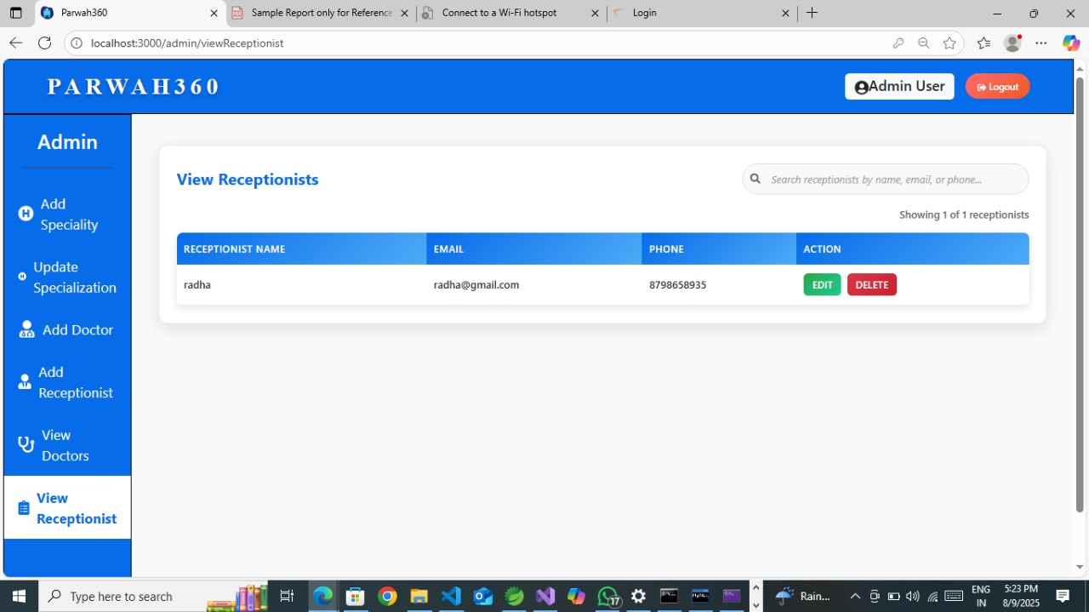
Admin Dashboard

Slide 17
Conclusion
Parwah360 simplifies hospital operations through a centralized digital platform.
Improves efficiency in patient registration, appointments, prescriptions, and payments.
Provides secure, role-based access for patients, doctors, and administrators.
Reduces manual work, errors, and delays with automation.
Enhances overall healthcare service quality — truly delivering “Care from all angles.”

Slide 18
Thank You

